Slide 1
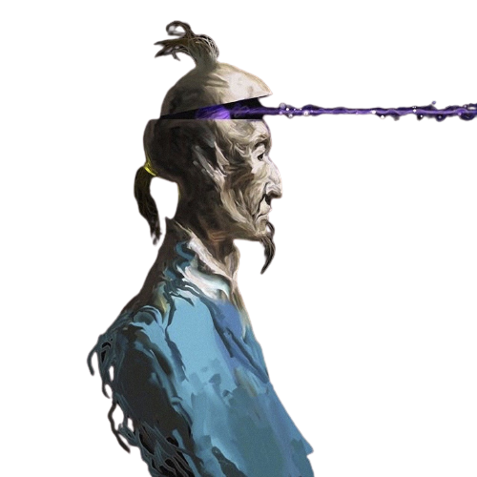
“No one ever complains about a speech being too short!”
Notes:
“No one complains about a speech being too short!”

Slide 2

PUBLIC SPEAKING
Notes:
First of all, I want to respect to teacher and hello to my dear friends. Today I’m here to present to everyone about my topic that descibe about public speaking.

Slide 3
WHAT IS YOUR BIGGEST
FEAR?
Notes:
before I explain the this topic I want to ask you want question.
What is your biggest fear?

Slide 4

70% of the population with a fear of Public Speaking
Notes:
We know in nowaday, 70% of the population with a fear of public speaking.
The next think is about

Slide 5
6 TIPS THAT CAN HELP YOU TO BE A GREAT SPEAKER
Notes:
6 tips that can help you to be a great speaker.

Slide 6







How to be a better public speaker
OPENING
BODY
EYE CONTACT
VOICE
STRUCTURE
IDEAS
Notes:
The last one is body : work on your body language...

Slide 7


CONCLUSION
Notes:
In the end, for conclusion. To make a long story short. Public speaking is determined by the speaker's intent when addressing a particular audience. To be a great speaker during presentation we must have opening, eye contact, structure, ideas, voice, and the last one is body languages.

